Slide 1
Bilingualism (and Multilingualism)
Jocelyn Marzan
University of the Philippines - Manila

Slide 2
OUTLINE (53 slides)
Characteristics of Bilingualism
Parameters of Language Affected by Bilingualism
Bilingual Processing and Language Learning
Thinking Through Clinical Issues in the Philippine Setting

Slide 3
General Comments
2/3 of the world is in some way bilingual
Every language reflects a culture
Flexibility derived from bilingualism

Slide 4
General Comments
Languages vs dialects
Dialect = variations of a language; “80-90%” comprehensible to speakers of other varieties of the same language (Singaporean English, Australian English, American English, Filipino English)
Languages = mutually incomprehensible, perhaps despite similar roots (e.g. French/Spanish/Portuguese/Italian, Tagalog/Ilocano/Cebuano, Mandarin/Hookien/Tae Chew, etc.)

Slide 5
Characteristics of Bilingualism

Slide 6
How many languages?
Non-Tagalog Rural Province ≥ 4
Ibanag
Ilocano
Filipino (Tagalog)
English
Tagalog Provinces ≈ 2
Tagalog
English

Slide 7
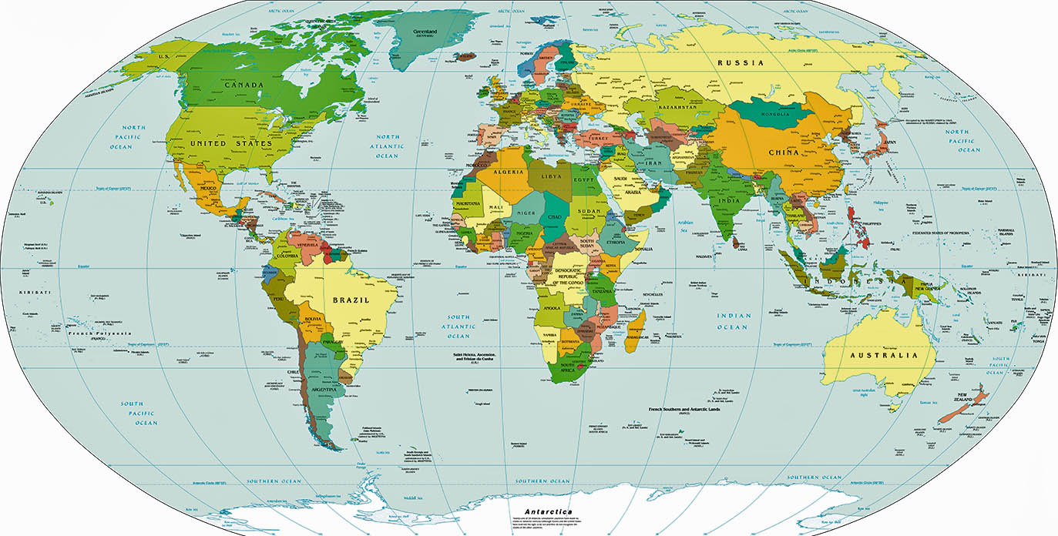
http://www.worldatlas.com/worldmaps/worldpoliticallarge.jpg
WORLD POLITICAL ,MAP

Slide 8
http://www2.johnabbott.qc.ca/~geoscience/ME/WorldLanguageFamiliesMap.htm
Stephen Bryce, Chair of Geography at John Abbot College, Quebec, Canada

Slide 9
How many language systems?
Tagalog – AUSTRONESIAN
VSO, 23 affixes for verb inflection
English – GERMANIC
SVO, 3 verb affixes (-ed, -ing, [-s]) for time and person
Mandarin – CHINESE
no affixation
Spanish – ROMANCE
drop subject, 5 verb affixes for time and 6 for person

Slide 10
Learned when and where?
Temporal order
Sequential = L1, l2 [provinces]
Simultaneous – both before 3 yo = BFLA [cities]
Contexts – both learned in same contexts?
Coordinate bilingualism – yes; translational equivalents
Compound bilingualism – no; distinct lexicon and function
Impact of bilingual education policies

Slide 11
Potential Impact on Code Mixing
Simultaneous & Coordinate  constant code mixing for optimal expressions
Simultaneous & Compound  code mixing due to lack of equivalent lexicon

Slide 12
How learned? Mode of Acquisition
Immersion (usually prior to puberty)
Implicit learning of rules
Formal instruction
Explicit learning of rules
Language interference (interlanguage)

Slide 13
Proficiency Across Domains*
Listening
Speaking
Reading
Writing
Combinations

Slide 14
Relative Proficiency*
Passive
Dominant
Balanced
Equi- or Ambilingual
Notes:
*code switching patterns
*Bilingual stroop tests
Passive
Exposed to, but not fluent in, a language
Some comprehension
Dominant
Native or near native in one language
Less skilled in the other; still developing; not stable
Balanced
Approach equivalence in 2 languages (conversational)
Equilingual/Ambilingual – equivalent in all domains
Semilingual (?)
substandard compared with monolingual

Slide 15
Language Dominance
Measure of relative proficiency in a language, capturing how much one knows about one language relative to the other (Anaya et al 2016)
VS
Function of current situation
Priming
Frequency of use
Context of use, etc

Slide 16
Mode of Use
Monolingual – Bilingual continuum
How often and for how long?
Impact on lexical access, syntax use, etc
Notes:
Purely monolingual task; with persons who speak only one language
Bilingual task, with persons who engage in constant code
Switching
Mixing
Borrowing
Switch – complete shift for a word/phrase/sentence
Borrow – word/expression from “weaker” language and adapted morphosyntactically (and sometimes phonologically) to base language

Slide 17
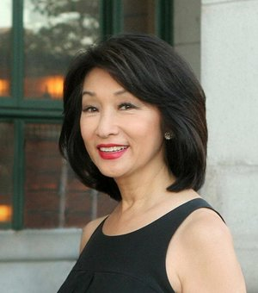
Parameters of Language Affected by Bilingualism
Voice quality – Connie Chung
Intonation patterns
Gusto kong puMAsok
I want to GO in
I want to go IN
Notes:
duquesne

Slide 18
Parameters of Language Affected by Bilingualism
Phonology
Vowel space
Treatment of clusters
Peruvian
Korean
Presence of fricatives – f p
Notes:
duquesne

Slide 19
A range of F1-F2 combinations is accepted as typical of each vowel

Slide 21
r
w
r
l
r
l

Slide 22
Parameters of Language Affected by Bilingualism
Semantics
Lexicon
Idioms
Syntax – word order, affixation, etc.
Pragmatics – Ma’am, wait for prompt before making comment
Notes:
duquesne

Slide 23
Bilingual Processing and Language Learning

Slide 24
Mother Language Education
Some evidence, but not rigorous
Diane Decker – madrasa schools
Dina Ocampo – impact on reading
Learning how to learn in the language that they know (with educational materials and support)
Learning the future medium of instruction
Using the new medium

Slide 25
Language Tagging
Per word then per language vs per language then per word
Mommy in French, Daddy in English vs simultaneous code mixing
“Ano ito [kutsara] sa English?”

Slide 26
Code Switching and Mixing
Code Switch – between sentences, or to different persons
Code mixing
Intra sentential – Kakain ako ng ice cream
Intra word – mag-i-ice cream ako (nagcollege, gumraduate)
Rules of code mixing
Base language of code mixing

Slide 27
http://www.gov.ph/2013/05/15/republic-act-no-10533/
Basic education shall be delivered in languages understood by the learners as the language plays a strategic role in shaping the formative years of learners.
For kindergarten and the first three (3) years of elementary education, instruction, teaching materials and assessment shall be in the regional or native language of the learners. The Department of Education (DepED) shall formulate a mother language transition program from Grade 4 to Grade 6 so that Filipino and English shall be gradually introduced as languages of instruction until such time when these two (2) languages can become the primary languages of instruction at the secondary level.
For purposes of this Act, mother language or first Language (LI) refers to language or languages first learned by a child, which he/she identifies with, is identified as a native language user of by others, which he/she knows best, or uses most. This includes Filipino sign language used by individuals with pertinent disabilities. The regional or native language refers to the traditional speech variety or variety of Filipino sign language existing in a region, area or place.

Slide 28
BUILDING PROFICIENCY THROUGH LANGUAGE (MOTHER TONGUE-BASED MULTILINGUAL EDUCATION) http://www.gov.ph/k-12/
Students are able to learn best through their first language, their Mother Tongue (MT). Twelve (12) MT languages have been introduced for SY 2012-2013: Bahasa Sug, Bikol, Cebuano, Chabacano, Hiligaynon, Iloko, Kapampangan, Maguindanaoan, Meranao, Pangasinense, Tagalog, and Waray. Other local languages will be added in succeeding school years.
Aside from the Mother Tongue, English and Filipino are taught as subjects starting Grade 1, with a focus on oral fluency. From Grades 4 to 6, English and Filipino are gradually introduced as languages of instruction. Both will become primary languages of instruction in Junior High School (JHS) and Senior High School (SHS).
After Grade 1, every student can read in his or her Mother Tongue. Learning in Mother Tongue also serves as the foundation for students to learn Filipino and English easily.

Slide 29
Noun: Category & Language
Noun Category | Proportion of Tokens
 | English | Tagalog
animal | 95% | 5%
apparel/footwear | 87% | 13%
body parts | 29% | 71%
food or drink | 78% | 22%
object | 53% | 47%
persons | 73% | 27%
places | 33% | 67%
plants | 100% | 0%
toys | 96% | 4%
TOTAL | 69% | 31%
ENGLISH
Animals
Clothing
Food
Persons
Plants
Toys
TAGALOG
Body parts
Places
Notes:
Among the nouns, we see a preference for using Tagalog for some categories and English for others.
Counting the number of times ANIMALS, TOYS and PLANTS were named, 95%-100% of the time in English
CLOTHING, FOOD ITEMS and PERSONS (teacher, sister) were labeled in English 70-90% of the time
On the other hand, there was a preference for using tagalog to label PLACES (kwarto, taas – which in Tagalog is noun) and BODY PARTS

Slide 30
Verb Category & Language
Language of stem | All |  | Top 50 |  | Top 25
Tagalog | 252 | 48% | 27 | 54% | 14 | 56%
English | 262 | 50% | 23 | 46% | 11 | 44%
Other | 8 | 2% | 0 | 0% | 0 | 0%
All | 522 | 100% | 50 | 100% | 25 | 100%
Other Language = Spanish; child-invented form with verb inflection (e.g. “kiklingkling ko ha” re: bell)
Top 50 = 50 most frequently occurring verbs; used at least once in more than 10 different half-hour recordings
Top 25 = 25 most frequently occurring verbs; used at least once in more than 18 different half-hour recordings
Tagalog : English
50 : 50
Notes:
With regard to verbs, on the other hand, we see an almost equal use of the two languages for the 522 verbs in the corpus.
A list of the 50 most frequently used nouns and 50 most frequently used verbs in Tagalog and English was part of the output of this study and can be obtained upon request.

Slide 31
Borrowing & Assimilation
Natural to language contact
Words borrowed frequently and almost universally  assimilated
Mesa, kutsara (cuchara), mouse, kompyuter (computer), university (unibersidad, universidad, pamantasan)

Slide 32
Thinking Through Clinical Issues in the Philippine Setting

Slide 33
Psychometrics
Notions of test development and test adaptation
NOT translation
For example:
Notion of pakikipagkapwa (personality)
Notion of tolerance of variability in verbal expression?

Slide 34
One language only?
Current guidelines: strongly recommend that parents speak to their children in their home language (Fredman, 2006)
SLPs urged to abandon the traditional practice of counseling parents to switch to the mainstream language of the community to make it easier for them to learn that language (cf. Juarez, 1983).
Formerly common practice
now seen as outdated
widely seen as originating with the inappropriate counseling practices of monolingual therapists.

Slide 35
Psycholinguistic concerns
Number and complexity of “rules” and forms to be learned
Overlap and differentiation
School success

Slide 36
Sociolinguistic Considerations
Surrounded by bilingualism – making it possible for them to rise to this challenge
Use of mother tongue for personal relationships
Loss of contact with relatives who do not speak a language

Slide 37
Thordardottir et al 2015 Mono- or Bilingual Intervention for Primary Language Impairment (PLI)
McGill University, Montréal, Québec, Canada

Slide 38
Careful experimental controls
Random assignment to treatment conditions
A no-treatment control group
Blinded assessment
Pre and post vocabulary & MLUw
Reliability measures
transcription, coding of MLUw, etc

Slide 39
Participants
have primary language impairment (PLI aka SLI) as diagnoses by SLP
speak a minority native language
Arabic = 1
Bangla = 1
Bengali = 3
Chinese = 2
Dutch = 1
English - 1
Japanese = 1
Kabyl = 1
Punjabi/Urdu = 8
Russian = 2
Sinhalese = 1
Spanish = 4
Tamil + 3

Slide 40
Participants
N = 29
Random assignment via https://www.randomizer.org/
11 monolingual treatment
9 bilingual treatment
9 no treatment (delayed treatment)

Slide 41
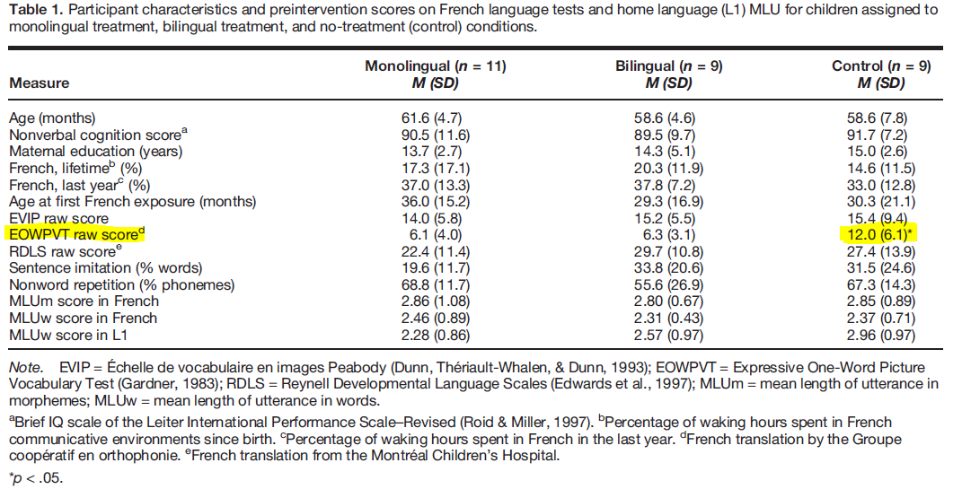
Participants

Slide 42
Intervention (50 mins weekly x 16 wks)
Language Stimulation for Vocab (20min)
4 verbs
6 nouns
New words from CDI added if child mastered target
Syntax – S + V + O [+ C]

Slide 43
Pre- & Post Test for Vocabulary
Probe of 47 words from CDI
selected for each child from a larger list of 47 age-appropriate vocabulary items based on the MacArthur–Bates Communicative Development Inventory (CDI) in Québec French (Trudeau, Frank, & Poulin-Dubois,1999). 12 action verbs and 35 nouns (8 vehicles, 8 clothing, 8 referring to food items, 4 insects, 8 body parts, 2 concepts)

Slide 44
Pre & Post-test for Syntax
Story retell – 2 equivalent stories
21 sentences (existence, action, locative action (bringing), locative state (being somewhere), possession, and quantity ( plural).
Each sentence = 2-4 constituents (reference, subject, verb, direct object, indirect object, location adverbial).
Wordless picture books (Man’s Work and Baby Sitter, both by Annie Kubler, 1999a, 1999b)

Slide 45
Pre & Post-test for Syntax
Not sentence imitation, hence gave 1 point for each sentence constituent that they included (e.g., agent, action), even if paraphrasing occurred
Ignored as morphological errors if the meaning was still clear.
E.g. 3 out of 4 possible points
Target = Claire verse du lait pour Marie (Claire pours milk for Marie)
Response = Claire met du lait (Claire puts milk)

Slide 46
Intervention
Monolingual
French only (L2); parent watch
Bilingual
French and L1; parent taught to provide stimulation, joined in session with SP
No therapy
delayed until completed 16 weeks

Slide 47
Results
No significant differences in standardized scores after 16 weeks

Slide 48
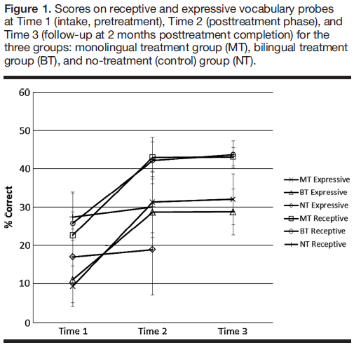
Results
Vocabulary probes
Both MONO and BILINGUAL better than NO THERAPY
But NO DIFFERENCE between mono and bilingual

Slide 49
References
Dijkstra T and Van Heuven WJB (2002). The architecture of the bilingual word recognition system: From identification to decision. Bilingualism: Language and Cognition. 5 (3), 175-197.
Flege JE, Yeni-Komshian GH and S Liu (1999). Age constraints on second-language acquisition. Journal of Memory and Language. 41, 78-104.
Fredman, M. (2006). Recommendations for working with bilingual children—Prepared by the Multilingual Affairs Committee of IALP. Folia Phoniatrica et Logopaedica, 58, 458–464.
Grosjean F (1998) Studying bilinguals: Methodological and conceptual issues. Bilingualism: Language and Cognition. 1, 131-149.
Hakuta, K (1998?). Paper presented at a working conference convened by the Centro de Estudios sobre Bilinguismo in San Juan, Puerto Rico, May 4&5, 2001.
Holowka S, Brosseau-Lapre, F and LA Petitto (2002). Semantic and conceptual knowledge underlying bilingual babies’ first signs and words. Language and Learning. 52 (2), 205-262.
Nakada, . Yukihiko F and I Kwee (2001). Brain strategies for reading in the second language are determined by the first language. Neuroscience Research. 40, 351-358.
Sadlak, J (2000). Address at the opening of the UNESCO-European Centre for Higher Education.
Summer Institute of Linguistics (SIL) International. Ethnologue report for the Philippines. Accessed at http://www.ethnologue.com
Von Hapsburg D and Pena ED (2002). Understanding bilingualism and its impact on speech audiometry. JSLHR. 45, 202-213

Slide 50
Baker, Colin (2001) Foundations of Bilingual Education and Bilingualism (3rd ed). Buffalo: Multilingual Matters Ltd.
Carson, Arthur Leroy (1978). The Story of Philippine Education. Quezon City: New Day Publishers.
Central Intelligence Agency. Asia Maps. Perry Catañeda Library Map Collection. The University of Texas at Austin. Accessed at http://www.lib.utexas.edu/maps/middle_east_and_asia/asia_ref01.pdf on 12/2/2002.
Cheng, Winston, Tricia Olea and Jocelyn Marzan (2002) Speech-Language Pathology in the Philippines: Reflections on the Past and Present, Perspectives for the Future. Folia Phoniatrica at Logopedica 54:79-82.
Dekker, p. Gregory (1999). First language component literacy: a bridge over troubled waters. Paper presented to the Centennial Congress in Bilingualism. Manila, January 1999.
Department of Education, Culture and Sports [DECS of the Republic of the Philippines] (1974) Department Order No. 25, s. 1974: Implementing Guidelines for the Policy on Bilingual Education.
Department of Education, Culture and Sports [DECS of the Republic of the Philippines] (1987) Order No. 52, s. 1987: The 1987 Policy on Bilingual Education.
Gonzales, Andres and Sibayan, Bonifacio P (Eds.)(1988). Evaluating Bilingual Education in the Philippines (1974-1985). Manila: Linguistic Society of the Philippines.
Gonzales, Andrew (1999) The language planning situation in the Philippines. In Robert B. Kaplan and Richard B. Baldauf, Jr. (eds.), Language Planning in Malawi, Mozambique and the Philippines. Philadelphia: Multilingual Matters Ltd.
Gonzales, Andrew (2001). Notes on the Philippine and Puerto Rican Languages Situations. Paper presented at a Language Planning Meeting in Puerto Rico (May 3-5, 2001)
Grimes Barbara F and Grimes, Joseph E (2002) Ethnologue: Languages of the World, 14th Edition. SIL International. Accessed at http://www.ethnologue.com/show_map.asp?name=Philippines last updated July 2002. accessed on 12/2/2002.
Isidro, Antonio Santos (1949). The Philippine Educational System. Manila: Bookman, Inc
Ministri ng Edukasyon at Kultura or Ministry of Education and Culture [MEC of the Republic of the Philippines] (1978) MEC Order No. 22, s. 1978: Pilipino as Curricular Requirement in the Tertiary Level.
National Statistics Office [NSO of the Republic of the Philippines] (2002) Quickstat – November 2002. last updated November 2002. accessed at http://www.census.gov.ph/index/html on 30 Nov 2002.
Sibayan, Bonifacio P (1999) The Intelllectualization of Filipino and Other Sociolinguistic and Educational Essays. Manila: The Linguistic Society of the Philippines.
United Nations Educational, Scientific and Cultural Organization [UNESCO] (1984). Towards Universalization of Promary Education in Asia and the Pacific. Country Studies. Philippines. Bangkok: UNESCO Regional Office for Education in Asia and the Pacific.
Villanueva, Charles (1990). Educational Mangaement Information Systems (EMIS) in the Philippines. Bangkok: UNESCO.

Slide 51
Comeau, L., Genesee, F., Lapaquette, L. (2003). The modeling hypothesis and child bilingual code-mixing. The International Journal of Bilingualism, 7 (2), 113-126.
Davidson, D., Jergovic, D., Imami, Z., & Theodos, V. (1997). Monolingual and bilingual children’s use of the mutual exclusivity constraint. Journal of Child Language, 24, 3-24.
De Houwer, A. (in press). Early bilingual acquisition: Focus on morphosyntax and the separate development hypothesis. In J.F. Kroll & A.M.B. de Groot (Eds.), Handbook of bilingualism: Psycholinguistic approaches. Oxford: Oxford University Press.
De Keyser, R. & Larson-Hall, J. (in press). What does the critical period really mean? In J.F. Kroll & A.M.B. de Groot (Eds.), Handbook of bilingualism: Psycholinguistic approaches. Oxford: Oxford University Press.
Deuchar, M. (1999). Are function words non-language-specific in early two-word utterances? Bilingualism: Language and Cognition, 2 (1), 23-34.
Dijkstra, T. & Van Heuven, W. (2002). The architecture of the bilingual word recognition system: from identification to decision. Bilingualism: Language and Cognition, 5 (3), 175-197.
Döpke, S. (2000). Generation of and retraction from cross-linguistically motivated structures in bilingual first language acquisition. Bilingualism: Language and Cognition, 3 (3), 209-226.
Frank, I., & Poulin-Dubois, D. (2002). Young monolingual and bilingual children’s responses to violation of the mutual exclusivity principle. The International Journal of Bilingualism, 6, 125-148.
Gass, S. & Selinker, L. (2001). Second language acquisition: An introductory course. NJ: Hillsdale.
Juan-Garau, M. & Perez-Vidal, C. (2001). Mixing and pragmatic parental strategies in early bilingual acquisition. Journal of Child Language, 28, 59-86.
Kohnert, K.J., Bates, E., & Hernandez, A.E. (1999). Balancing bilinguals: Lexical-semantic production and cognitive processing in children learning Spanish and English. Journal of Speech, Language and Hearing Research, 42, 1400-1413.
Luce, P.A. & Pisoni, D.B. (1998). Recognizing spoken words: The neighborhood activation model. Ear and Hearing, 19 (1), 1-36.
Nicoladis, E. & Genesee, F. (1996). A longitudinal study of pragmatic differentiation in young bilingual children. Language Learning, 46 (3), 439-464.
Paradis, J., Nicoladis, E. & Genesee, F. (2000). Early emergence of structural constraints on code-mixing: Evidence from French-English bilingual children. Bilingualism: Language and Cognition 3(3), 486-512.
Quay, S. (1993) Bilingual evidence against the principle of contrast. Paper presented at the Annual Meeting of the Linguistic Society of America (67th, Los Angeles, CA, January 7-10, 1993). [abstract only; accessed via OVID]
Quinn, C. (2001). The developmental acquisition of English grammar as an additional language. International Journal of Language and Communication Disorders, 36 (supplement), 309-314. [abstract only; accessed via OVID]
Schelletter, C. (2002). The effect of form similarity on bilingual children’s lexical development. Bilingualism: Language and Cognition, 5 (2), 93-107.
Whong-Barr, M., & Schwartz, B. (2002). Morphological and syntactic transfer in child L2 acquisition of the English dative alternation. Studies in Second Language Acquisition, 24, 579-616.

Slide 52
Bautista, L (1999) An analysis of the functions of Tagalog-English code-switching: Data from one case. The Filipino Bilingual: A Multidisciplinary Perspective. Manila: Linguistic Society of the Philippines.
Clark EV and JB Grossman (1998) Pragmatics directions and children’s word learning. Journal of Child Language. 25: 1-18.
Comeau L, Genesee F and L Lapaquette (2003) The Modeling Hypothesis and child bilingual codemixing. The International Journal of Bilingualism. 7(2): 113-126.
De Houwer, A (in press) Early bilingual acquisition: Focus on morphosyntax and the separate development hypothesis. In JF Kroll and AMB de Groot (eds.), Handbook of Bilingualism: Psycholinguistic Approaches. Oxford: Oxford University Press.
De Keyser R and J Larson-Hall (in press). What does the critical period really mean? In JF Kroll and AMB de Groot (eds.), Handbook of Bilingualism: Psycholinguistic Approaches. Oxford: Oxford University Press.
Deuchar M (1999) Are function words non-language-specific in early bilingual two-word utterances? Bilingualism: Language and Cognition. 2(1): 23-34.
Ellis N (2002) Frequency effects in language processing. Studies in Second Language Acquisition. 24: 143-188.
Gass SM and L Selinker (2001). Second Language Acquisition. NJ: Lawrence EarlbaumAssociates.
Gonzales, A (1999) The language planning situation in the Philippines. In RB Kaplan and RB Baldauf, Jr. (eds.), Language Planning in Malawi, Mozambique and the Philippines. Philadelphia: Multilingual Matters Ltd.
Hall DG, Burns TC and JL Pawluski (2003) Input and word learning: caregiver’s sensitivity to lexical category distinctions. Journal of Child Language. 30: 71-729.
Holowka S, Brosseau-Lapre F, Petitto LA (2002) Semantic and conceptual knowledge underlying bilingual babies’ first signs and words. Language Learning. 52(2): 205-262.
Kim M, McGregor KK, and CK Thompson (2000). Early lexical development in English- and Korean-speaking children: Language-general and language specific patterns. Journal of Child Language. 27: 225-254.
Lahey M (1988) Language Disorders and Language Development. NY: Macmillan Publishing Company.
Masataka N (1998) Perception of motherese in Japanese sign language by 6-month-old hearing infants. Developmental Psychology. 34(2): 241-246.
Naigles LR and E Hoff-Ginsberg (1998) Why are some verbs learned before other verbs? Effects of input frequency and structure on children’s early verb use. Journal of Child Language. 25: 95-120.
Paradis J and S Navarro (2003) Subject realization and crosslinguistic interference in the bilingual acquisition of Spanish and English: what is the role of input? Journal of Child Language. 30: 371-393.
Paradis J, Nicoladis E and Genesee F (2000). Early emergence of structural constraints on code-mixing: Evidence from French-English bilingual children. Bilingualism: Language and Cognition. 3(3): 486-512.
Pascasio E (1981) Book Review - The Filipino bilingual’s competence: A model based on analysis of Tagalog-English code switching. Philippine Journal of Linguistics. 12(1): 85-87.
Petitto LA, Katerelos M, Levy BG, Gauna K, Tetreault K and Ferraro V (2001) Bilingual signed and spoken language acquisition from birth: Implications for the mechanisms underlying early bilingual acquisition. Journal of Child Language. 28: 453-496.

Slide 53
Dijkstra, T and Van Heuven WJB (2002) The architecture of the bilingual word recognition system: From identification to decision. Bilingualism: Language and Cognition. 5(3), 175-197.
Elman, JL, EA Bates, MH Johnson, a Karmiloff-Smith, D Parisi and K Plunkett (1996). Why connectionism? In Rethinking Innateness: a connectionist perspective on development. MA: MIT Press
Grosjean, F. (1998). Studying bilinguals: Methodological and conceptual issues. Bilingualism: Language and Cognition 1, 131-149.
Luce, P. and Pisoni, D. (1998). Recognizing spoken words: The neighborhood activation model. Ear and Hearing. 19 (1), 1-36.
McClelland, J. and Elman, J. (1986) The TRACE model of speech perception. Cognitive Psychology 18, 1-86.

