Slide 1
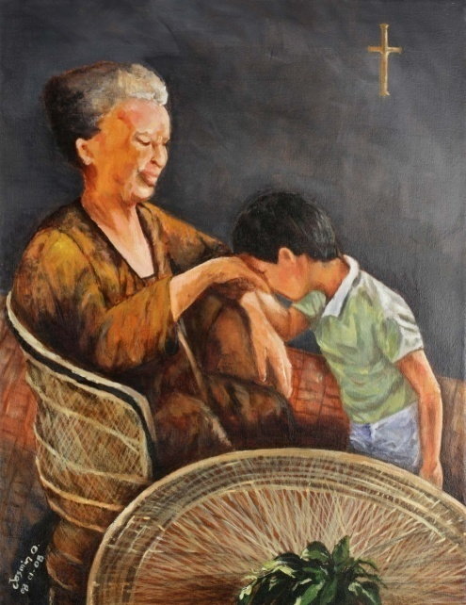
Interprofessional Collaboration:
Professional
Experiences of a Filipino Speech Pathologist

Slide 2
Professional Identity

Slide 3
Competencies
Professional personhood
Ethics
Values

Slide 4
Individual + Collective = Team

Slide 5
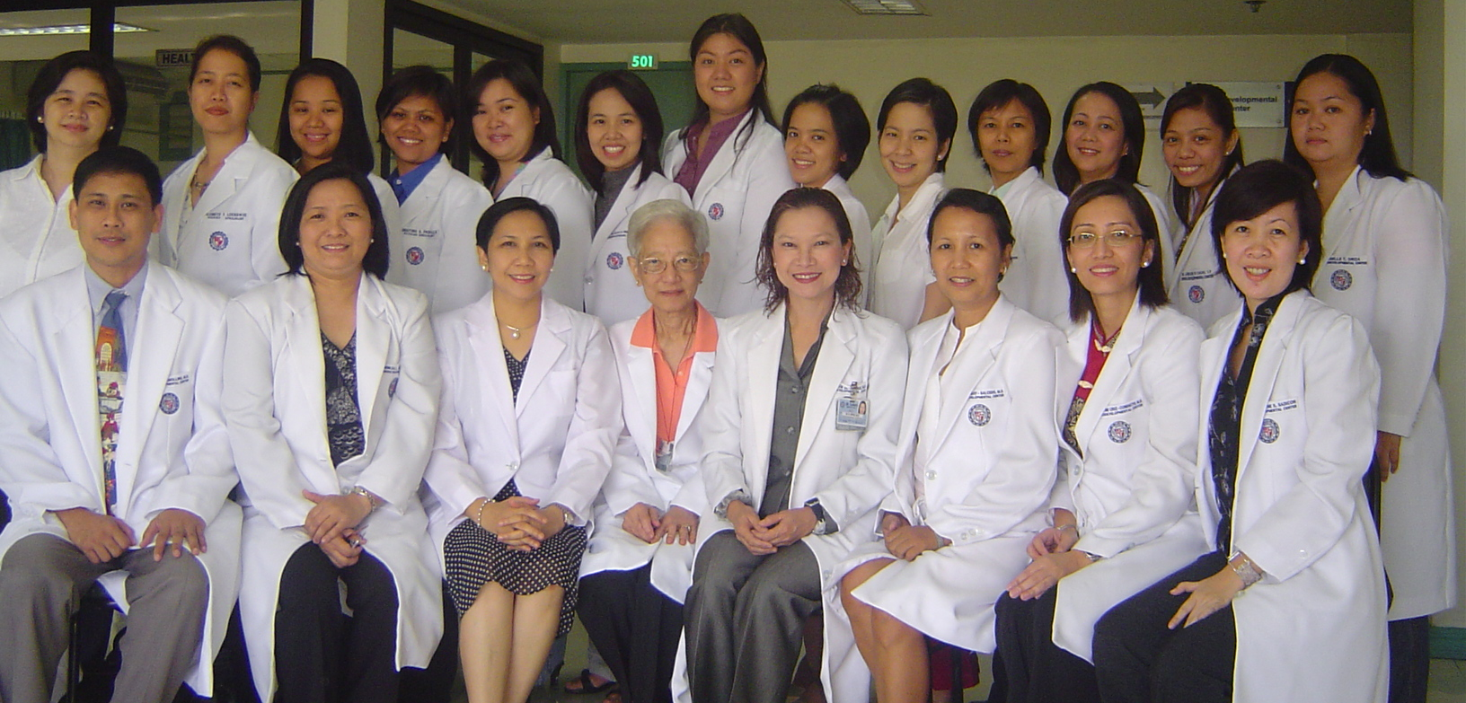
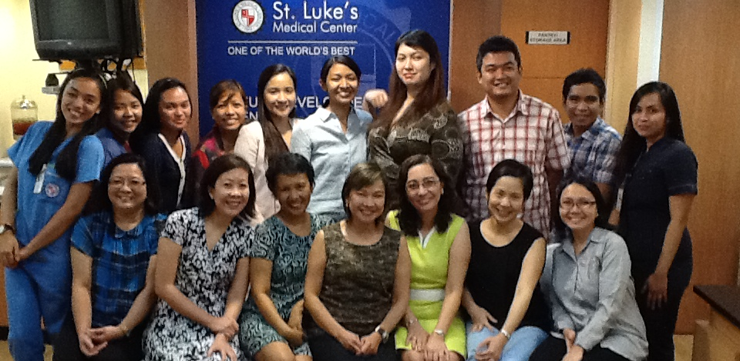

Slide 6
Variety of Diversity
Disparity of Diversity

Slide 7
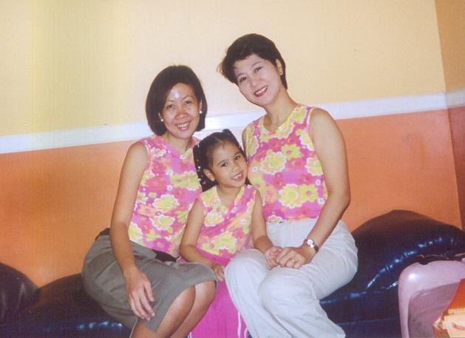

Slide 8
HOW and WHAT

Slide 9
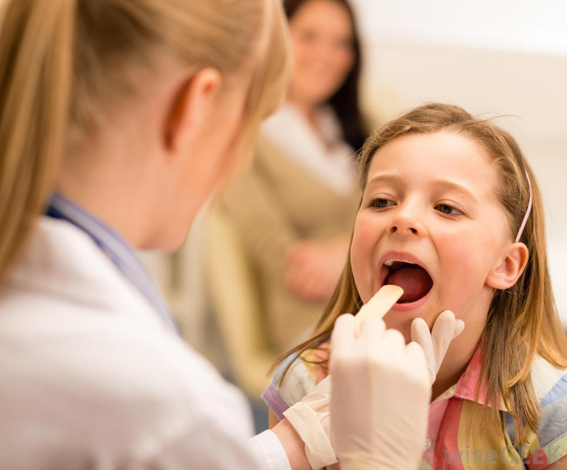
Gap between current health professions programs and actual practice needs and realities

Slide 10
“Start with what they know…
Build on what they have.”
- Chinese Proverb

Slide 11
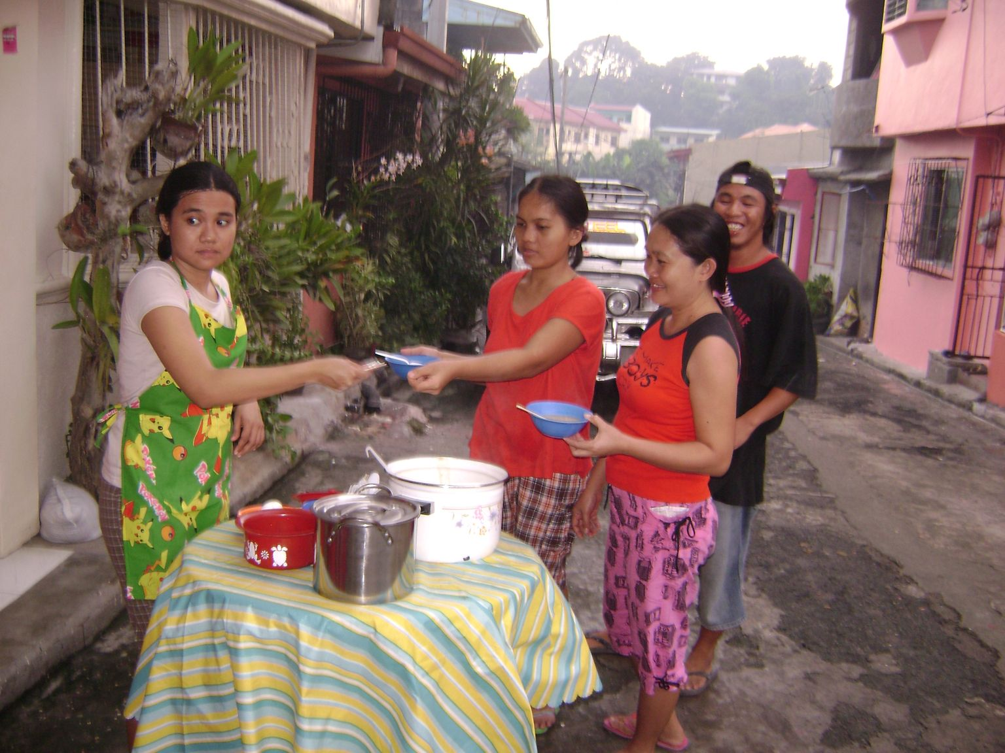

Slide 12
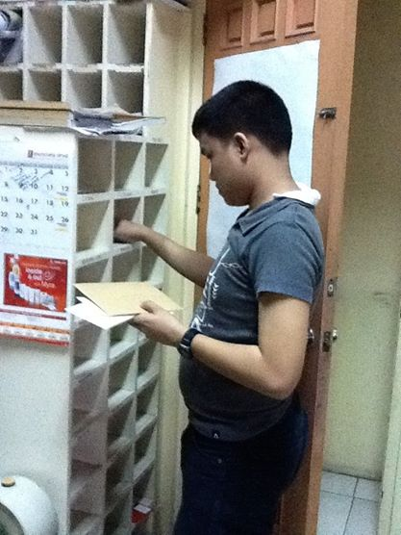
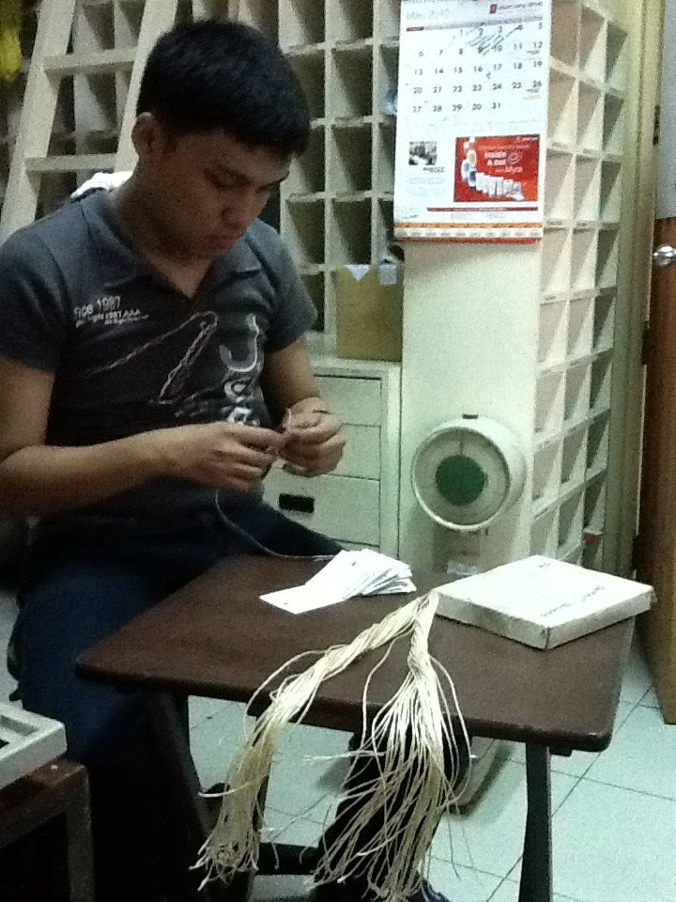

Slide 13
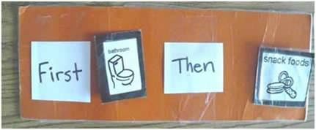

Slide 14
Exposure/introduction
Immersion/development
Competence (entry to practice)

Slide 15
Relinquishing
professional
autonomy

Slide 16
Critical engagement
Family involvement

Slide 17
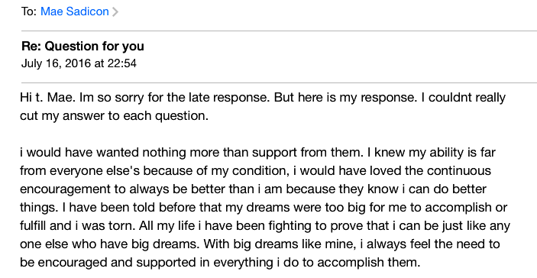

Slide 18
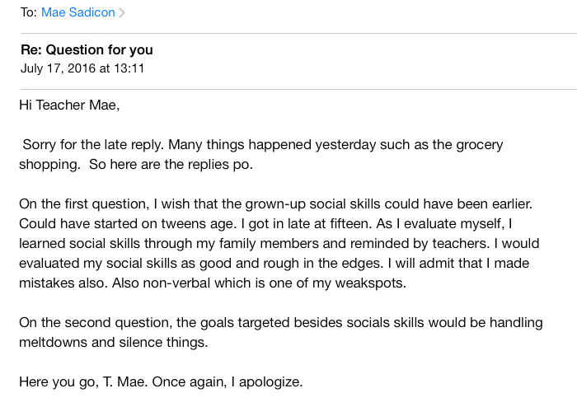

Slide 19
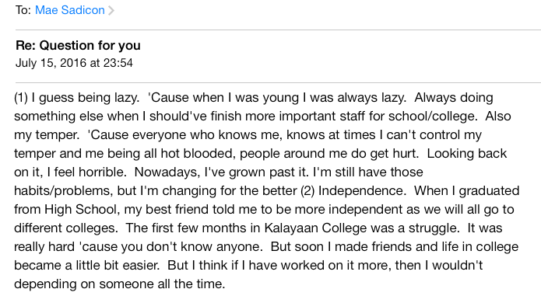

Slide 20
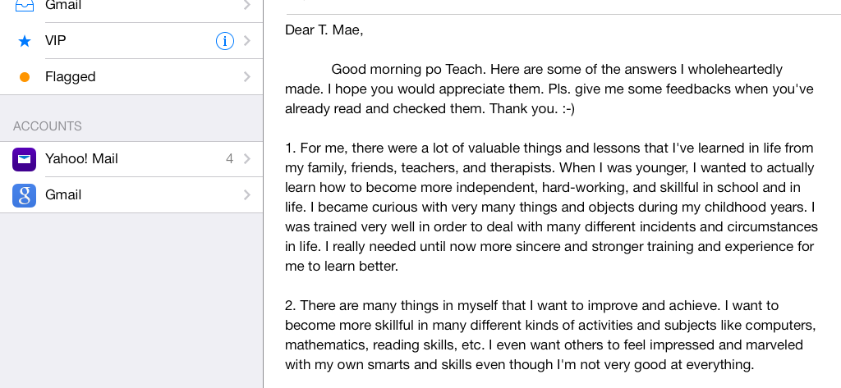

Slide 21
padayon,
SLPs

