Slide 1
INTERPROFESSIONAL COLLABORATION
GENEVIEVE RIVADELO-CABALLA, PHD, PTRP
SPED Teacher; School Administrator; Inclusive Education Consultant
cc: Jordi Payà Canals - https://www.flickr.com/photos/24630636@N03
Notes:
Good am dear colleagues, mentors and friends ☺ It is an honor to be invited to be part of the panel discussion on Interprofessional Collaboration in my capacity as a Special Education Teacher and School Administrator. I have been working with Speech Pathologists for more than 20 years already, from the time I was a PT intern in UP-CAMP and we had to participate in Interdisciplinary Conferences for children referred to RRDC, now known as the Clinic for Therapy Services. When I proceeded to pursue graduate studies in Special Education, I found myself having more opportunities to practice interprofessional collaboration.

Slide 2
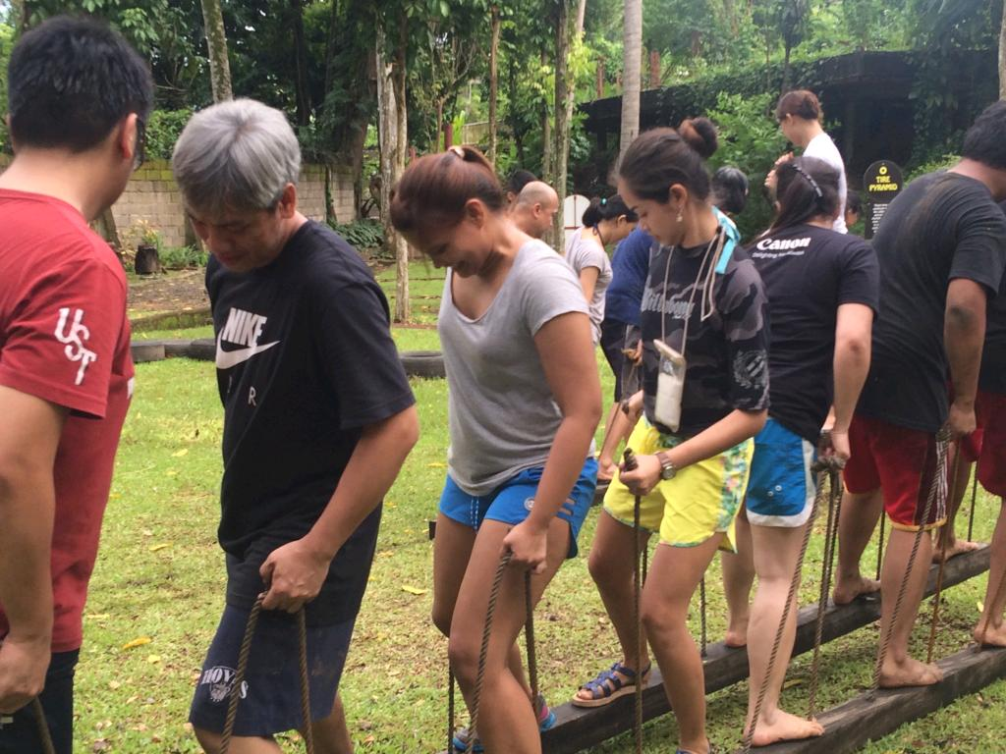
“Teams and their teamwork do not just happen; they have to be WORKED AT. It takes TIME for people to share, engage and solidify their ideas and relationships." (McCrea, 2015)
Notes:
This is my team trying to move forward by synchronizing their steps. It took several attempts before they figured out a strategy to make progress. Same goes for the unique relationship shared by SPED teachers, Speech Pathologists and the rest of the interdisciplinary team. Collaboration requires EFFORT as well as TIME, dedicated to finding creative solutions to conflicting perspectives and differences in ways by which ideas are communicated. In my 20 years of teaching, I have encountered attitudes and personalities that have challenged my normally exceptional patience and tolerance for diversity, and have learned significant lessons along the way about prudence and fortitude in the face of these difficult situations. For SPED teachers, collaboration is not a choice, but a NECESSITY.

Slide 3
Without INTERPROFESSIONAL COLLABORATION…
Notes:
This is what happens if we decide not to collaborate ☺ In most cases, next to the parent, the SPED teacher spends the most time with the child with special needs anywhere from 2 to as much as 6 hours a day, 5 days a week. Without helpful input from the interdisciplinary team, the SPED teacher would most likely not survive an entire school-year faced with a wide range of atypical behaviors, limitations and needs requiring curriculum modifications and teaching accommodations across multiple levels of ability and disability. For the past 40 years, since the passage of Public Law 94-142 in the US, one of the main responsibilities of a SPED teacher is to come up with an Individualized Educational Plan, more commonly referred to as the IEP. The IEP is the cornerstone of collaboration for the school-age child requiring the expert input of all members of the interdisciplinary team in a parent-led process of goal-setting and measurement of learning outcomes.

Slide 4
COLLABORATION HISTORY
[Practices as Professional Roles in McCrea, 2015]
Team Stakeholder
- Designing the IEP; Conducting Interdisciplinary Team Meetings PTCs
Policy Designer
- Internal Policies: ST Dept.
- External: National & Local Policies on Inclusive Education
Pedagogy Creator
- Incorporating ST Strategies in the Classroom (as indicated in IEP)
Rights Advocate
- Ensuring ACCESS to Early Intervention & Education
- Empowering Families of Children with Special Needs
cc: The Daring Librarian - https://www.flickr.com/photos/43666171@N07
Notes:
Since I started working with speech pathologists as early as 1995, I could summarize my collaboration history using the framework of McCrea who defined practices as professional roles. As I discussed in the previous slide, SPED teachers are primarily tasked to facilitate designing the IEP which would necessitate engaging the child’s interdisciplinary team to contribute to the formulation of annual goals and short-term objectives, as well as recommended differentiated learning experiences. I have enjoyed working with teams and learning from other professionals as a TEAM STAKEHOLDER. As a school administrator, I have also collaborated with my speech therapy team in designing internal POLICIES that would improve the quality of services we deliver to our students and the efficiency of our processes. Externally, I have worked with other professionals in drafting policies to improve access to early intervention and promoting inclusive education at both the local and national levels. “PEDAGOGY” has been defined as “the art & science of teaching.” In the classroom, the partnership of SPED teachers with SPs allows us to better communicate with our students and manage our expectations of their communicative abilities, as indicated in their IEPs. Lastly, I have collaborated with Speech Pathologists in ADVOCATING for greater access to early intervention, education, and inclusive disaster risk management especially for poor children with special needs who are twice marginalized by poverty & disability (e.g. Teacher Susie Pascual & Dr. Ferds Garcia).

Slide 5
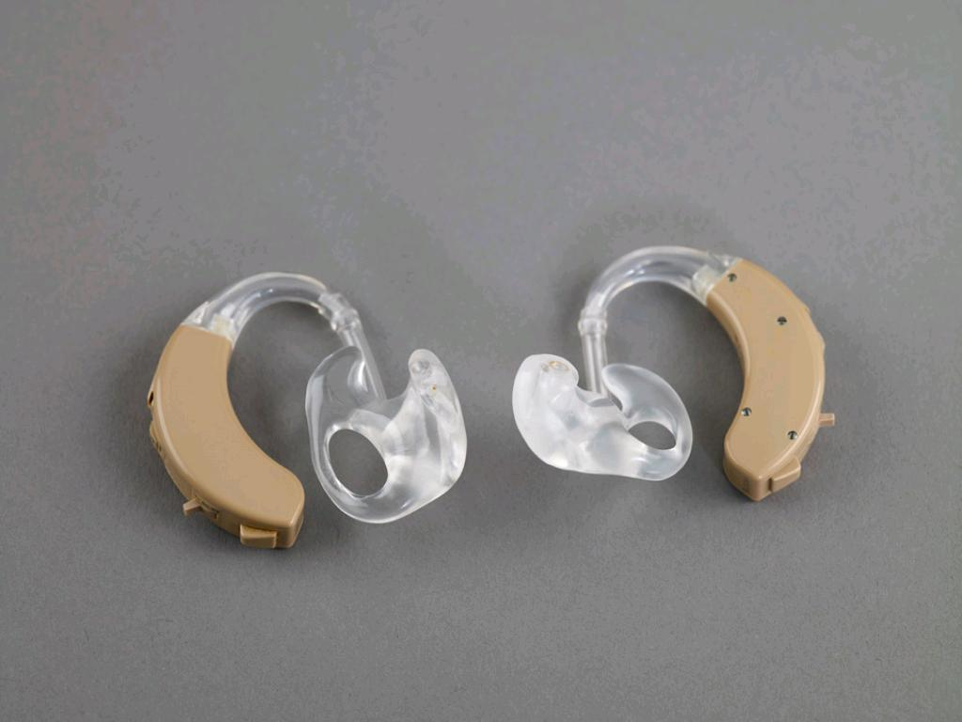
Whenever a student struggles to learn
in the classroom or appears inattentive, teachers should refer students to a
speech-language pathologist or audiologist for a hearing screening.
(Werfell & Hendricks, 2015)
cc: Birmingham Museum and Art Gallery - https://www.flickr.com/photos/35256023@N02
Notes:
I teach an Assessment Course in the College of Education, and I would always remind my students to refer and consult with a Speech Pathologist to rule-out hearing impairments whenever they encounter students with learning difficulties and attention deficits.

Slide 6
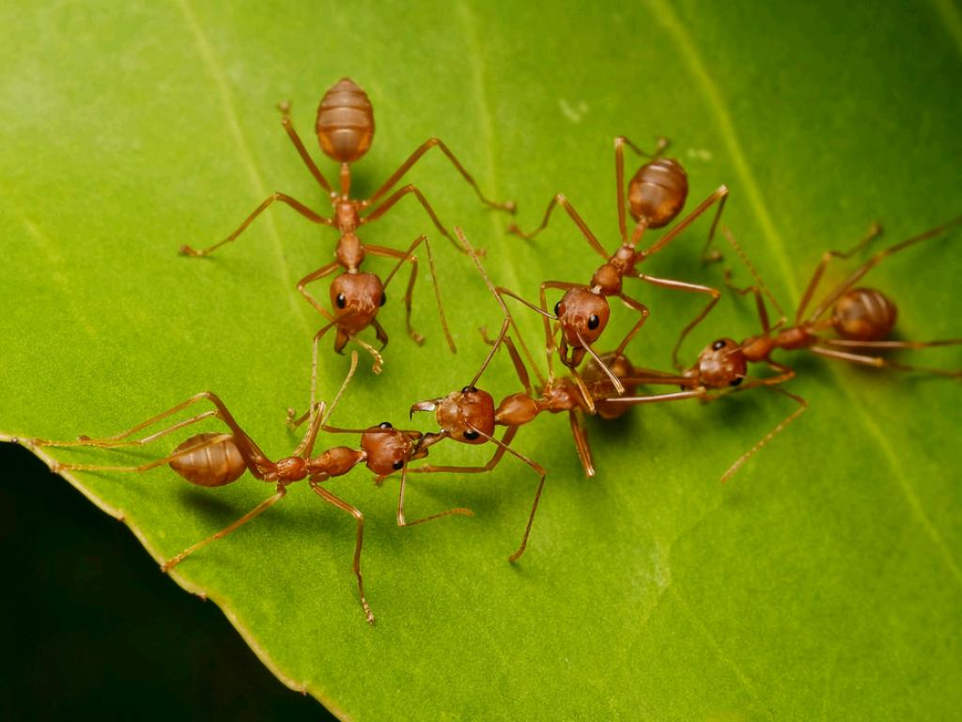
To ensure the success of students, interprofessional collaboration is essential. Each professional has specialized training and experience, and by combining experiences, professionals can create a plan for addressing minimal hearing loss in the classroom in ways that are not possible when each group
operates independently.
cc: Troup1 - https://www.flickr.com/photos/23271361@N06
Notes:
Like an army of ants, professionals have to value the unique role played by each member of the team towards a greater purpose, that is to optimize the potential of the child with special needs. No role is too small to be considered insignificant.

Slide 7
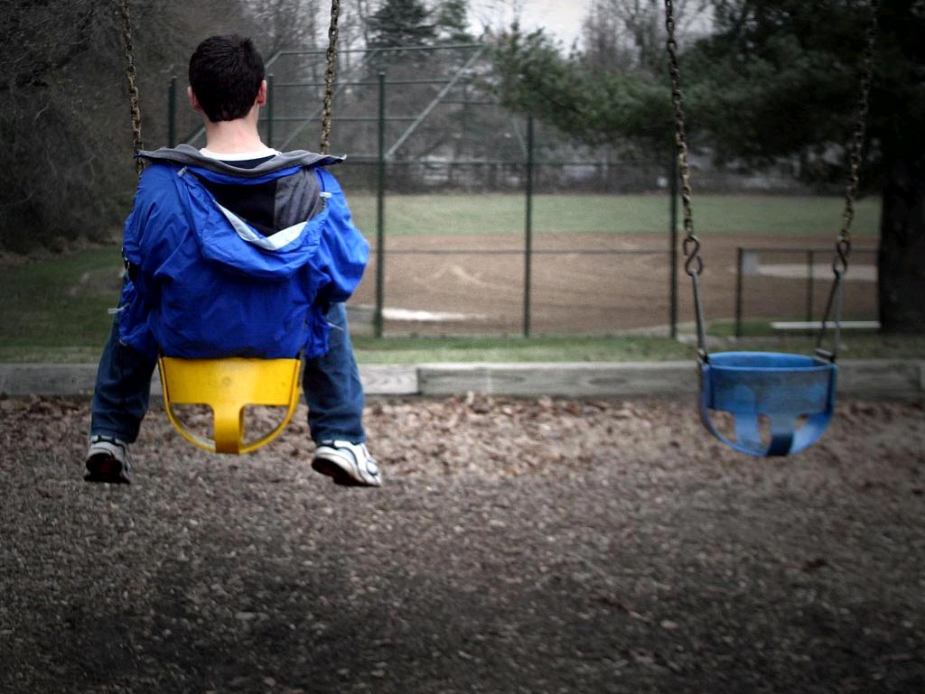
BREAKING DOWN BARRIERS
OF PROFESSIONAL ISOLATION
cc: physiognomist - https://www.flickr.com/photos/18636155@N00
Notes:
No one discipline can sufficiently address the complexity of learning and developmental issues of a child with special needs. The SPED teacher recognizes this and aims to break down professional barriers that hinder the full participation of every member of the team towards a common end.

Slide 8
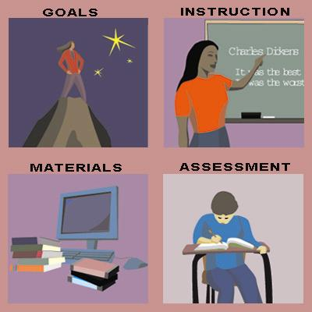
INTERPROFESSIONAL COLLABORATION for INCLUSIVE EDUCATION
Effective dialogue develops out of a growing TRUST, MUTUALITY of concern and an APPRECIATION of contrasting PERSPECTIVES. (Lawrence-Lightfoot, 2004).
cc: Vincepal - https://www.flickr.com/photos/27888006@N05
Notes:
Over the years, I have come to realize that “contrasting perspectives” is more of the norm, than the exception. Professionals use different lenses in interpreting situations, formulating goals, choosing instructional strategies and materials, and in conducting assessments. Making authentic inclusive education a reality necessitates authentic interprofessional collaboration.

Slide 9
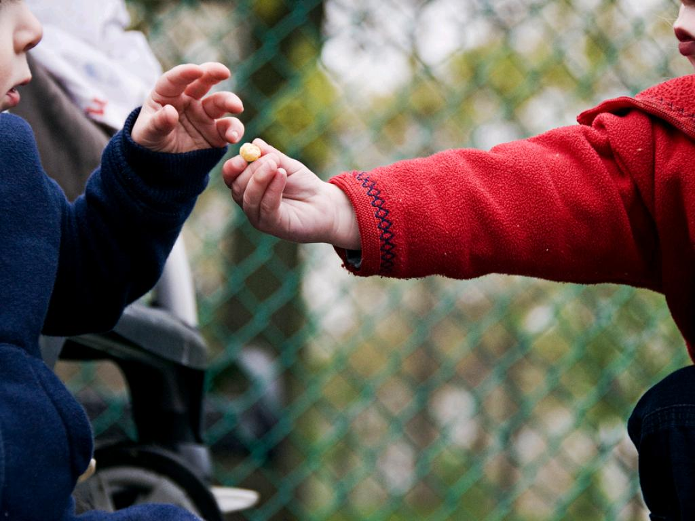
ROLE RELEASE - the relinquishing of professional roles
by sharing knowledge and skills to
other service providers (Gargiulo & Kilo, 2014).
cc: bengrey - https://www.flickr.com/photos/28196992@N07
Notes:
For this to be possible, there should be genuine “role release” wherein the sharing of best practices is done among professionals, within ethical professional boundaries. Particularly in developing countries such as ours, role release can spell the difference between access to needed intervention and deprivation. Considering the shortage of professional resources most especially in remote barangays, the SPED teacher is often tasked to assume a central role in delivering services using a transdisciplinary team approach. She needs to go beyond her traditional role as classroom teacher and be empowered by other professionals in incorporating specialized strategies to address the diversity of learning needs in a context that is wanting, yet with much creativity and resourcefulness, can be a wellspring of hope for the child with special needs.

Slide 10
AT IEP MEETINGS, ABOUT 80% OF COMMUNICATION
IS NON-VERBAL (LYTLE & BORDIN, 2001).
cc: Lars Plougmann - https://www.flickr.com/photos/75062596@N00
Notes:
Role release requires that we are secure in the roles that we play and our value as members of the team. SPED teachers should be excellent communicators, not just verbally and in writing, but more importantly, in exuding positivity and building an atmosphere of trust, respect and humble acknowledgement of individual differences. This is best tested during IEP meetings wherein the SPED teacher sets the stage for a rich and respectful exchange of ideas and opinions leading to the development of a relevant and appropriate IEP.

Slide 11
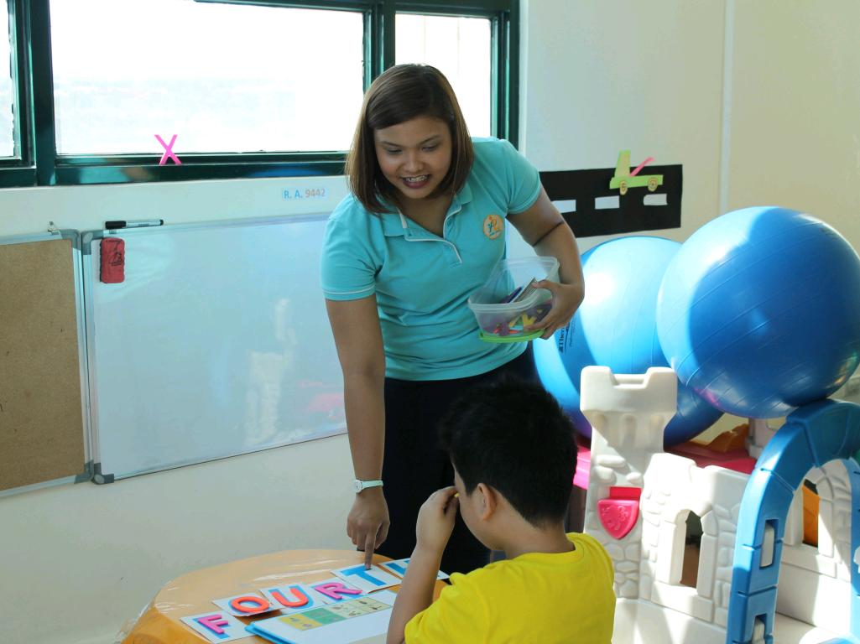
Collaborating on IEP development has the potential to create change in the way teachers TEACH and students LEARN.
(Clark, 2000)
Notes:
Change has come? Still not perfect, but I have witnessed how teams now have evolved to become more open in aligning goals and interventions in spite of individual differences towards the same end. When the team gets derailed, often it is reminded to shift the focus back to the child who glues the team together towards a common objective.

Slide 12
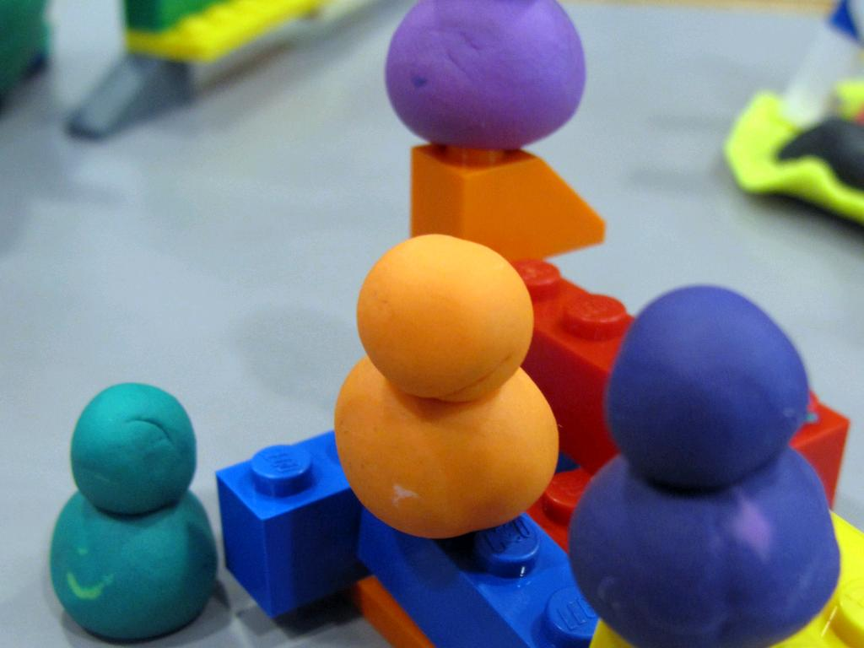
SUCCESSFUL IEP TEAM
COLLABORATION INVOLVES-
Mutual problem-solving & decision-making focused on the student;
An understanding of one's skills and abilities; and
A desire to create a meaningful educational plan.
cc: laurabillings - https://www.flickr.com/photos/14784969@N08
Notes:
In summary, successful IEP team collaboration involves …

Slide 13
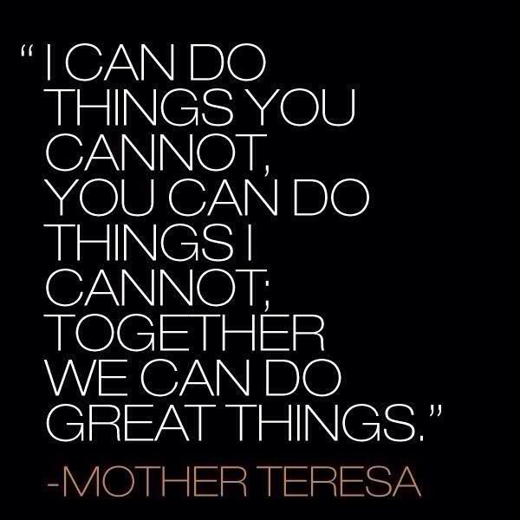
Notes:
Let me end with this quote from Mother Teresa … Congratulations PASP and a pleasant morning to all of you.

