Slide 1
NINE PLANES: Restructuring Models for Improving Clinical Judgment and Decision-Making
Jean christine vela, csp-pasp

Slide 2
Model thinking
Why Construct and Restructure Models?
Explanation does not imply prediction.
Models guide data collection.
Models illuminate core dynamics.
Models suggest analogies.
Models move us from “ignorant militance” to “militant ignorance”.
JOSHUA M. EPSTEIN
Professor – John Hopkins University
Advanced Modeling in the Social, Behavioral and Health Sciences

Slide 3
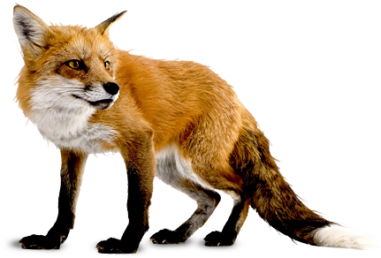
FOXES vs. HEDGEHOGS
Models entertain different perspectives (tolerant and pragmatic).
Easily re-interprets and recalibrates expectations.
Coming up with simplified goals and easy metrics.
ISAIAH BERLIN, PHILIP TETLOCK
Cites Greek poet Achilochus
“The fox knows many things, but the hedgehog knows one big thing.”

Slide 4
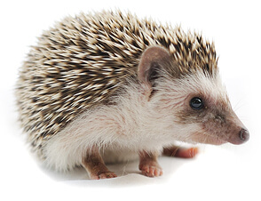
FOXES vs. HEDGEHOGS
Models are unambiguous, decisive and formulaic.
High-profile, urgent decisions.
Responsiveness to “new information”
ISAIAH BERLIN, PHILIP TETLOCK
Cites Greek poet Achilochus
“The fox knows many things, but the hedgehog knows one big thing.”

Slide 5
OBJECTIVES OF RESTRUCTURING MODELS
To allow for balanced visualization of causation as well as prediction.
To allow for therapists to quickly decide what to do during assessment and treatment without falling into linear thinking.
To provide a more organized view on the conceptual relationship of existent models.
To offer a more comprehensive view of speech-language and communication areas while using a simple visual.
THE NINE PLANES

Slide 6
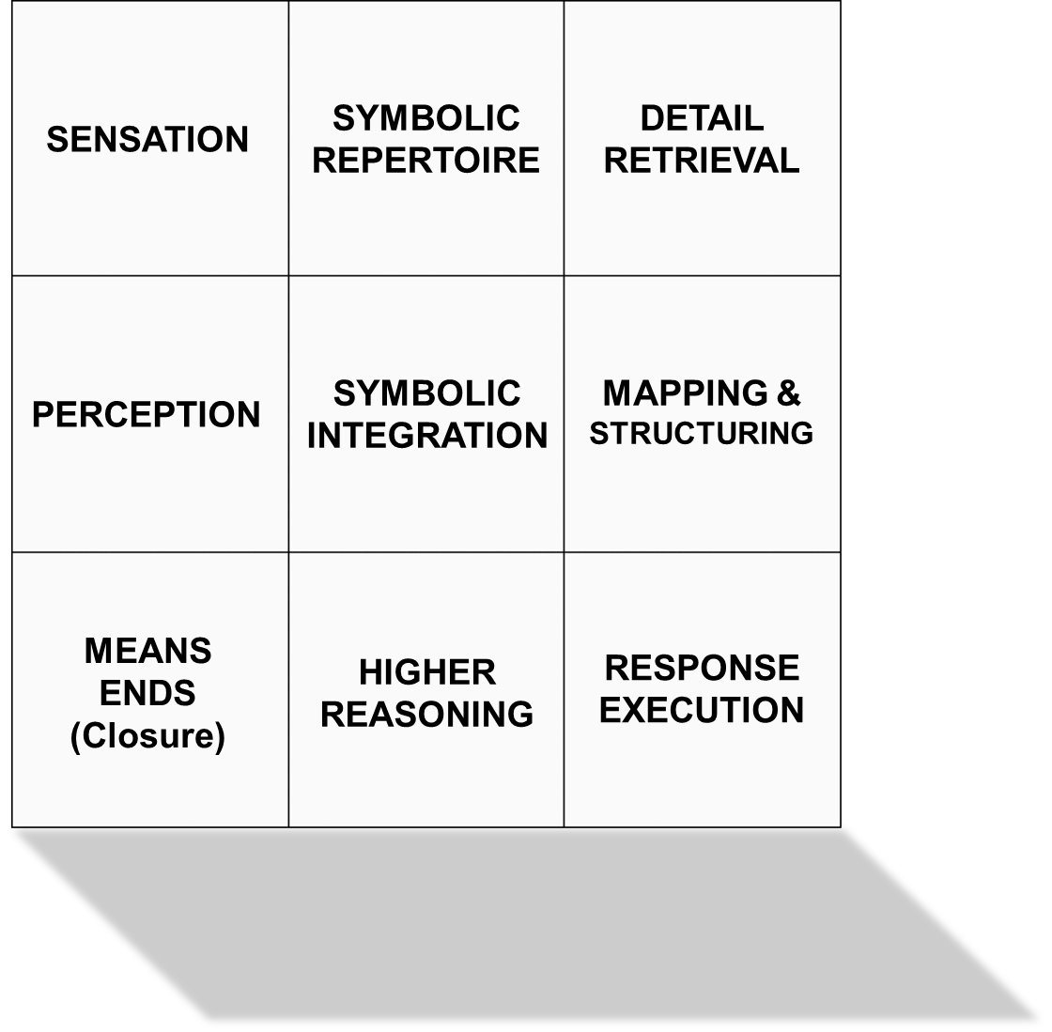
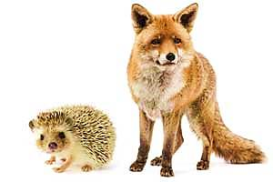
THE NINE PLANES
JEAN CHRISTINE VELA, CSP-PASP

Slide 7
SAMPLE APPLICATION 1
VOCABULARY AND BASIC CONCEPTS

Slide 8
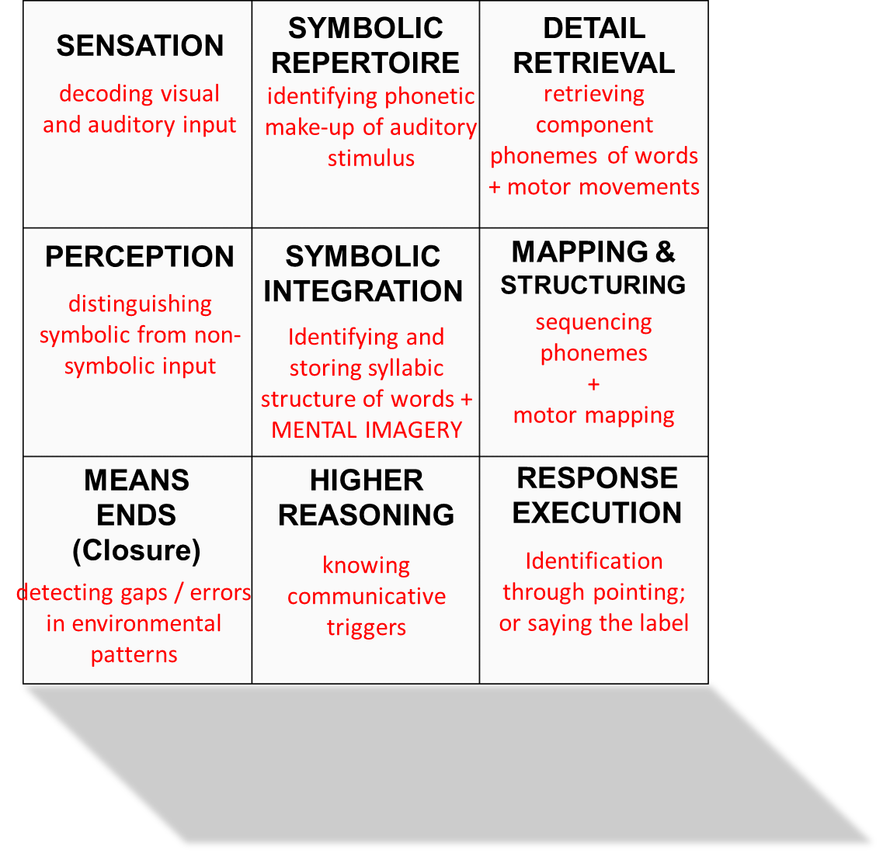
THE NINE PLANES
Sample Application 1: Vocabulary
JEAN CHRISTINE VELA, CSP-PASP

Slide 9
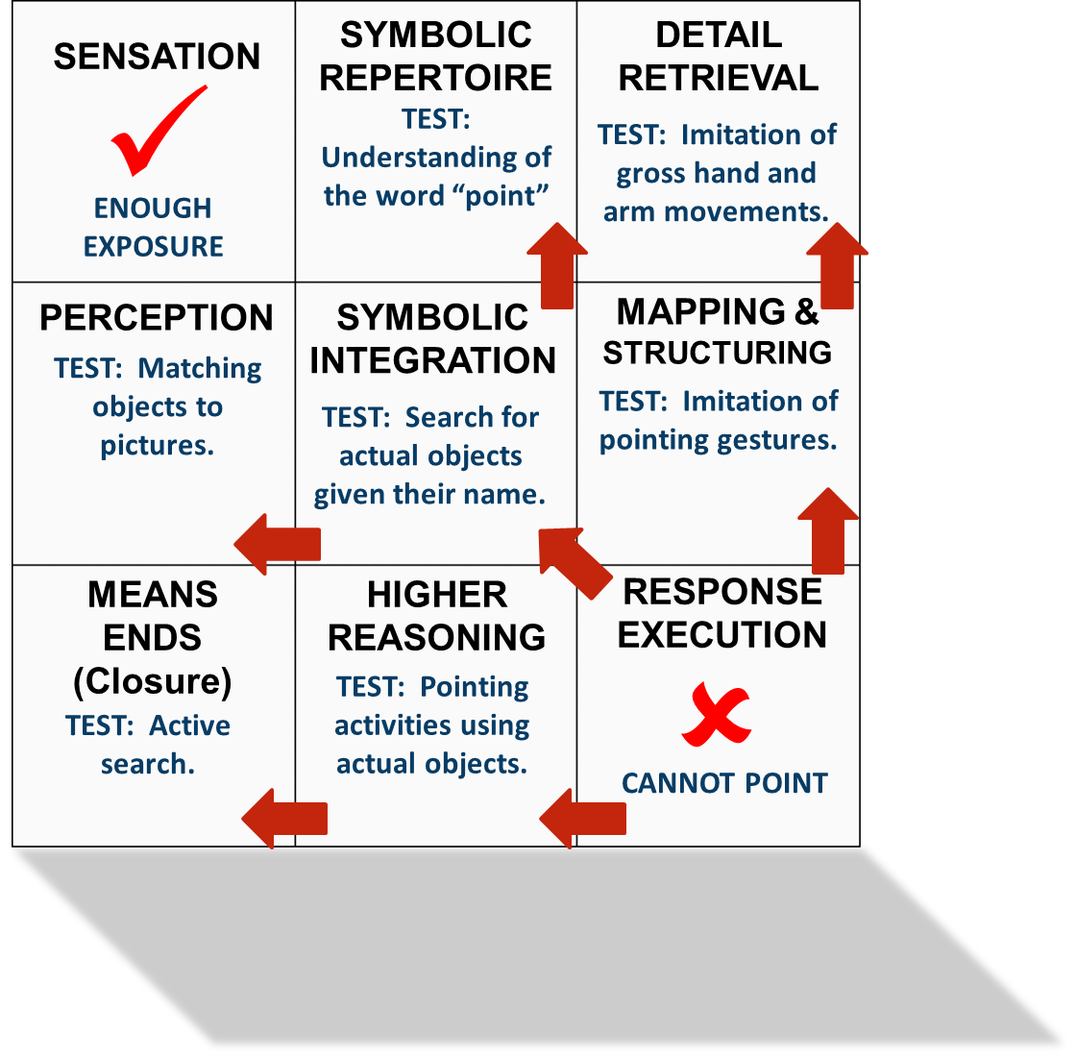
THE NINE PLANES
SAMPLE PROBLEM 1
(Assessment)
Client has been given enough exposure to the word “apple” during meals but still could not point them in pictures.
Sample Application 1: Vocabulary
JEAN CHRISTINE VELA, CSP-PASP

Slide 10
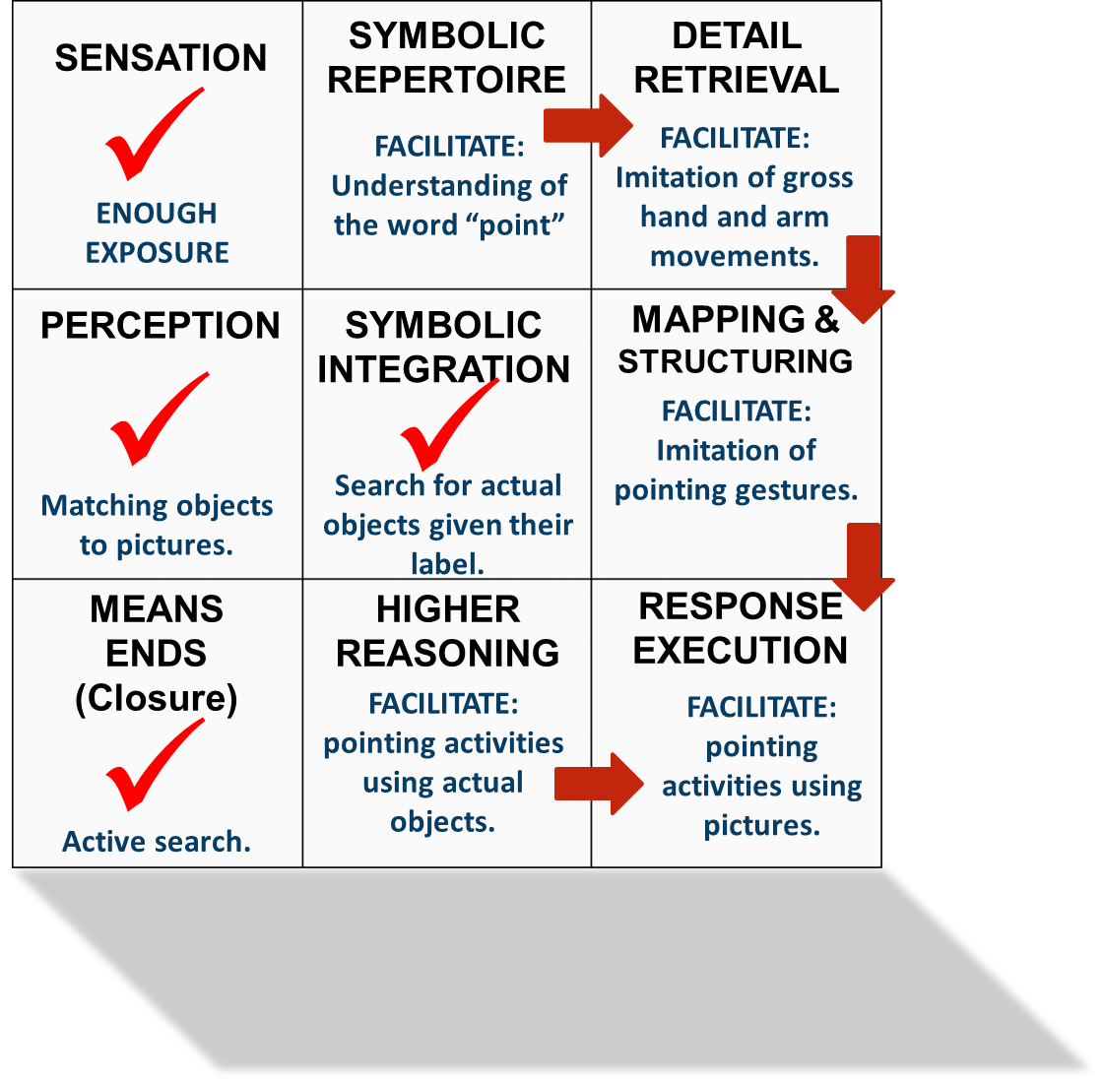
THE NINE PLANES
SAMPLE PROBLEM 1
(Intervention)
Upon testing, client was found to be able to match actual objects to pictures but is unable to follow the instruction to “point”. Active search is also intact given the name of the object.
Sample Application 1: Vocabulary
JEAN CHRISTINE VELA, CSP-PASP

Slide 11
SAMPLE APPLICATION 2
CODING TRUE-WORD COMBINATIONS

Slide 12
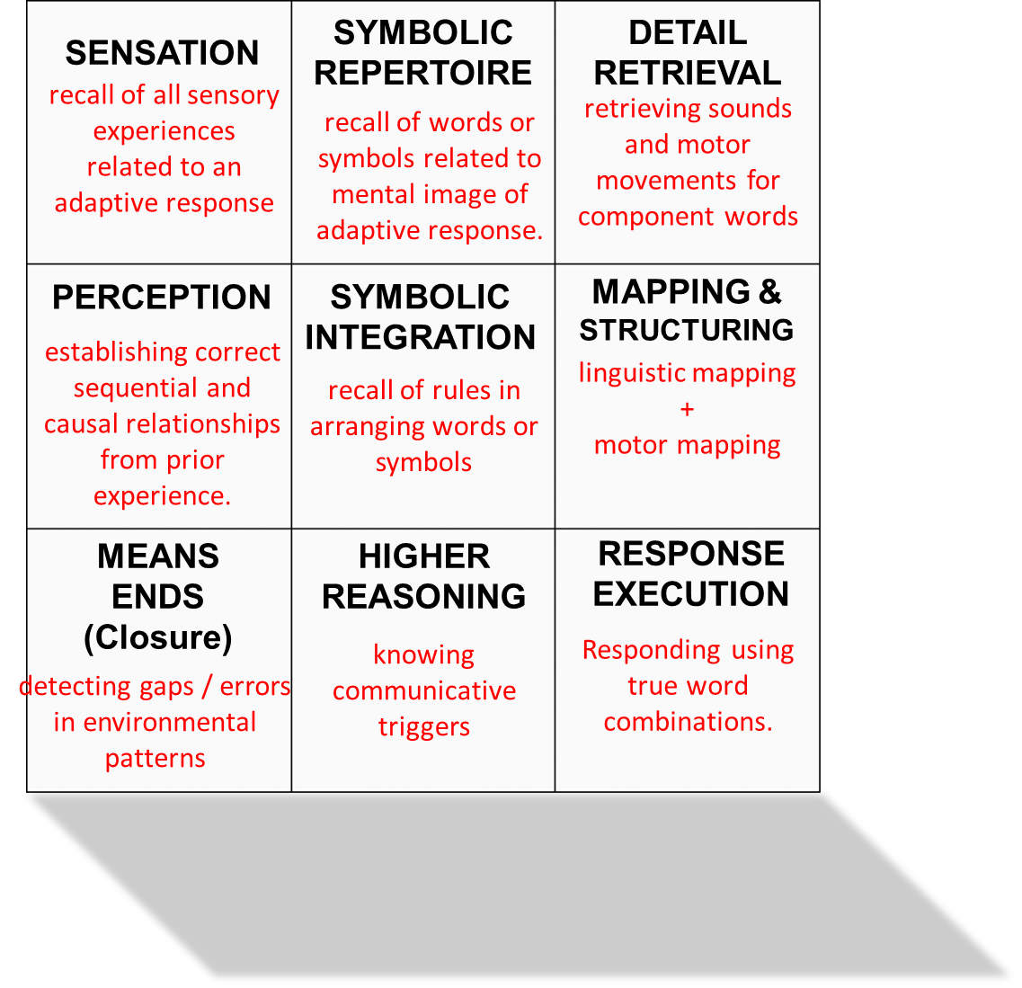
THE NINE PLANES
Sample Application 2: True Word Combinations
JEAN CHRISTINE VELA, CSP-PASP

Slide 13
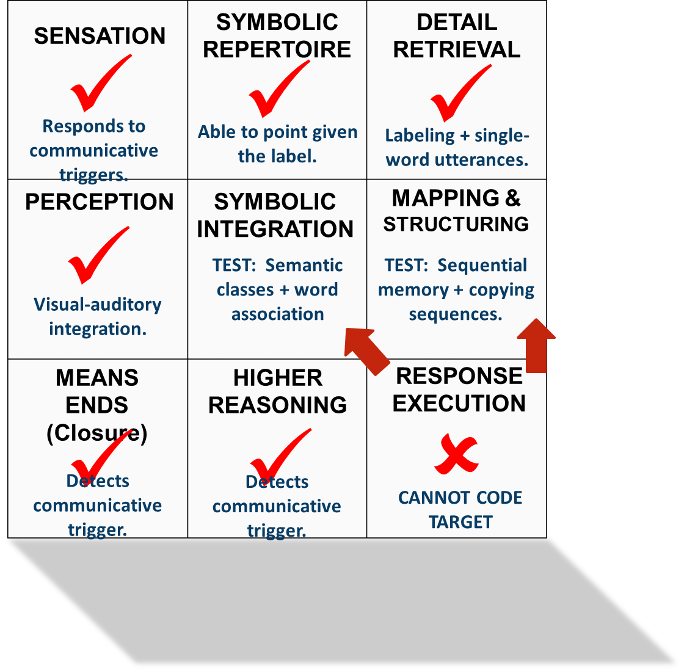
THE NINE PLANES
SAMPLE PROBLEM 2
(Assessment)
Client is able to point to words given their names and is able to label familiar objects and actions in various communication settings. However, client is unable to code 2-word combinations and sticks to single-word utterances.
Sample Application 2: True Word Combinations
JEAN CHRISTINE VELA, CSP-PASP

Slide 14
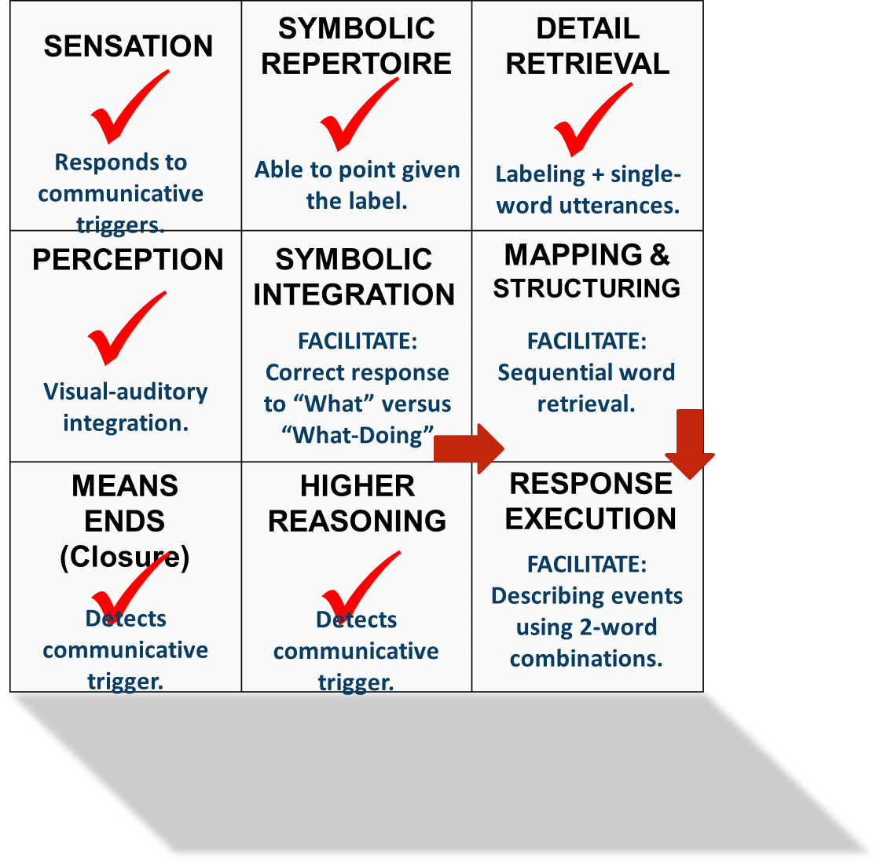
THE NINE PLANES
SAMPLE PROBLEM 2
(Intervention)
Upon testing, accuracy in responding to “What is this?” versus “What is the [agent] doing?” was inconsistent. Recall of components and sequences of word lists through a replication task was also inconsistent.
Sample Application 2: True Word Combinations
JEAN CHRISTINE VELA, CSP-PASP

Slide 15
SAMPLE APPLICATION 3
NARRATIVE LANGUAGE

Slide 16
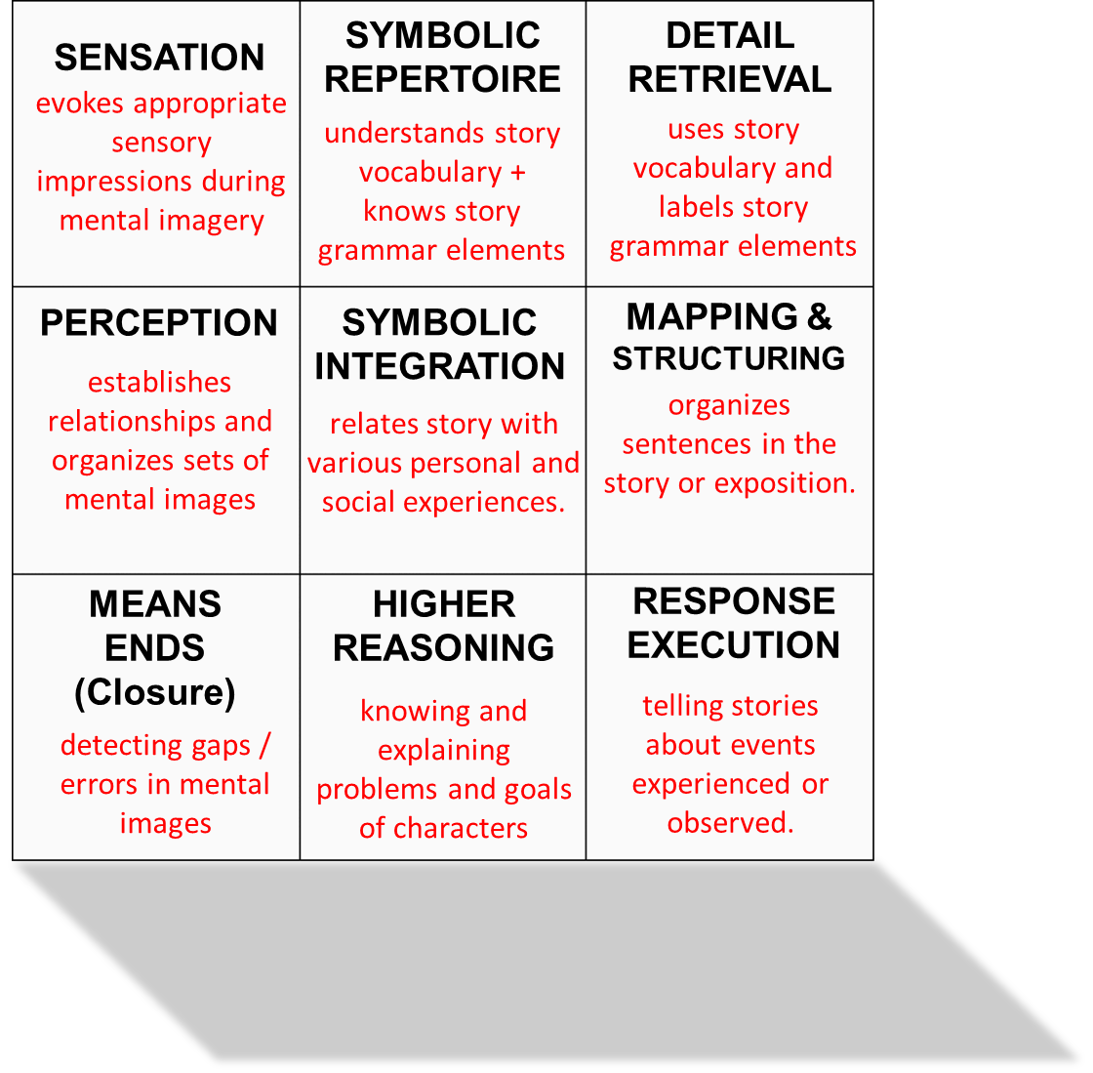
THE NINE PLANES
Sample Application 3: Narrative Language
JEAN CHRISTINE VELA, CSP-PASP

Slide 17
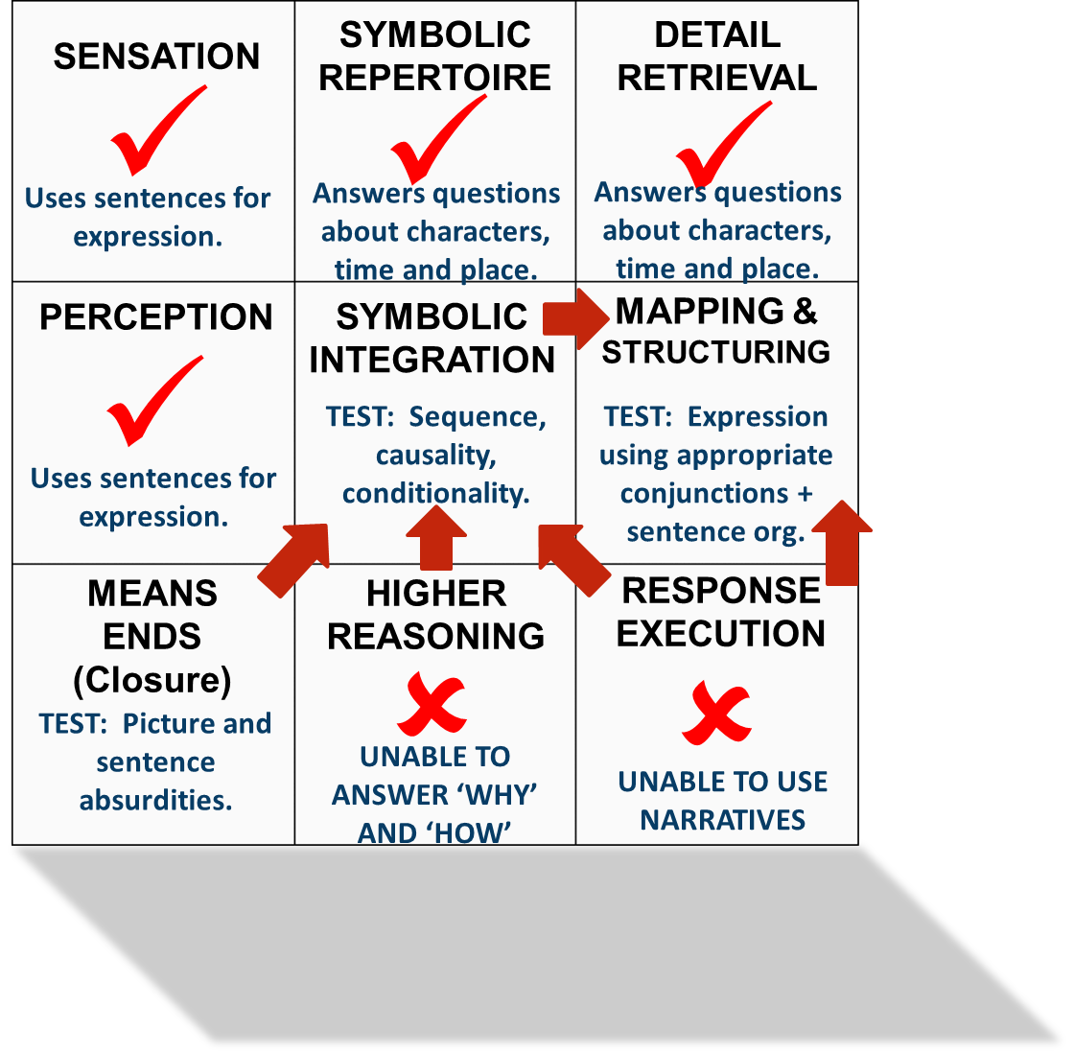
THE NINE PLANES
SAMPLE PROBLEM 3
(Assessment)
Client is able to code various sentence forms but is unable to relate his experiences using a narrative. He is able to answer questions about character, time and place details. However, he is unable to answer Why and How questions about experienced events.
Sample Application 3: Narrative Language
JEAN CHRISTINE VELA, CSP-PASP

Slide 18
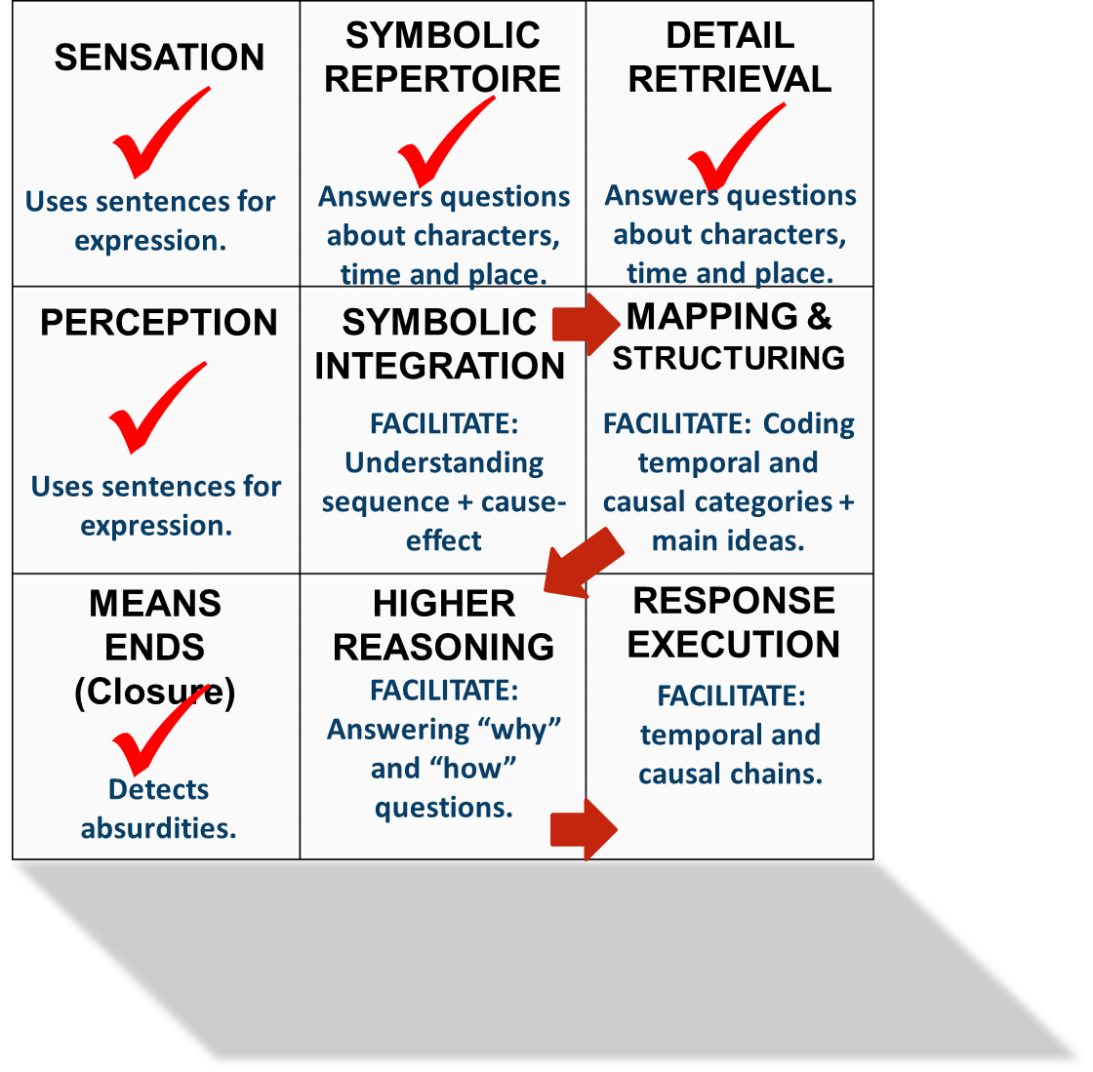
THE NINE PLANES
SAMPLE PROBLEM 3
(Intervention)
Upon evaluation, the child was seen to be able to detect absurdities in pictured events as well as in sentences. However, limitations were noted in understanding relationships among events. Difficulties were likewise noted in identifying main ideas and grouping (as well as enumerating) supporting details.
Sample Application 3: Narrative Language
JEAN CHRISTINE VELA, CSP-PASP

Slide 19
“All models are wrong but some are useful.”
GEORGE E.P. BOX
Statistician

